Slide 1
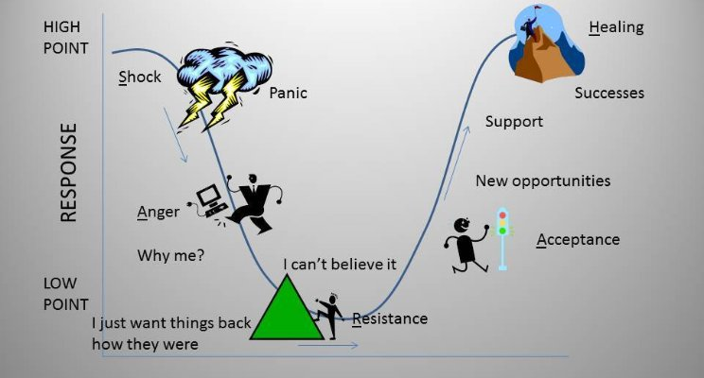
SARAH Model: Help With Emotions of Change
Time

Slide 2
Hijacking the Amygdala

Slide 3
What is Emotional or Amygdala Hijacking?
The amygdala is based at the center of the brain & controls responses to fear and empathy. When it feels threats, it responds not just irrationally, but destructively
The amygdala attacks the neo cortex, the thinking part of the brain. There is little or no ability to rely on intelligence reasoning when this happens

Slide 4
SARAH Model: Help With Emotions of Change
Shock
Anger
What? No Way!
How good things were in the past
It can’t happen here
Numbness
Refusing to hear new information
Whoever said this will be sorry!
Anger
Loss & Hurt
Stubbornness
Blaming others
Complaining
S Shock
A Anger
Resistance
Acceptance
A Acceptance
R Resistance
I get it…but I don’t
This has to be a mistake
This doesn’t apply to me
What’s the point of trying
Can’t we just go back?
This might just work
Seeing possibilities
Teamwork starts
Vision starts to develop
I can get on board, show me how

